Slide 1
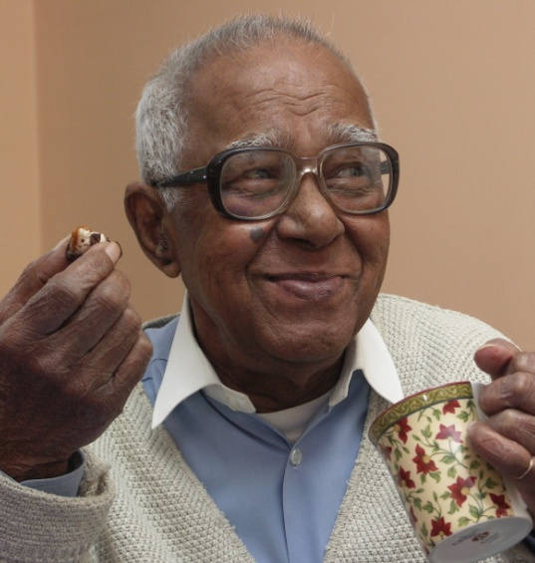
Joint working: key themes and lessons from around the country
Tony Hunter, Chief Executive, SCIE
5 October 2015

Slide 2
Leading effective implementation
Systems leadership, Merton
London Borough of Merton is piloting a systems leadership approach to the integration of health and social care.
The Systems Leadership initiative has led to a co-production process between health and social care, with good feedback loops between the front line, middle managers, clinicians and the senior leadership group
Have formed a ‘do-ers’ group at operational level to bring in Systems Leadership approaches across the board, not just at senior level
Dorset, Bournemouth and Pool
Through their ‘Better Together’ programme, Dorset, Bournemouth and Poole have looked to bring services into a coherent local system, in order to deliver integrated health and social care.
It has started with senior leaders working together to a shared vision across health and social care, pooling budgets and working on a common strategy to redesign integrated services.

Slide 3
Leading and managing co-ordinated delivery teams
Multi-professional teams in Dudley
In Dudley, services are being re-organised around GP practices, with GPs as core members of Practice-oriented Multi-Professional Teams.
These teams include link workers from mental health, social services and the voluntary sector, as well as local community nurse services and pharmacists.
This diverse group of professionals work together for the same shared group of GP registered residents – helping to share responsibility
Buckinghamshire’s Multi-agency Group
Buckinghamshire’s Multi Agency Group is a team of professionals from health, mental health and social care with a GP at the centre.
The majority of practices in Buckinghamshire hold regular Multi Agency Group meetings to discuss the most vulnerable people with the most complex conditions
A lead professional is assigned to each case, providing support and interventions for people and carers to keep them well and independent in their own homes.

Slide 4
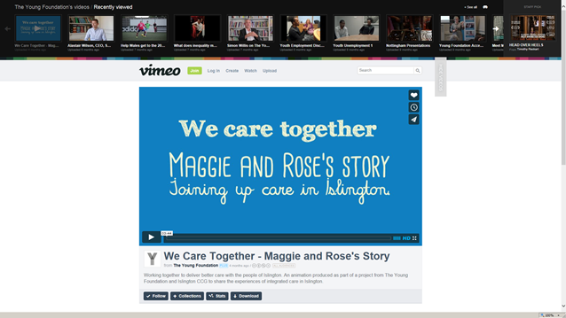
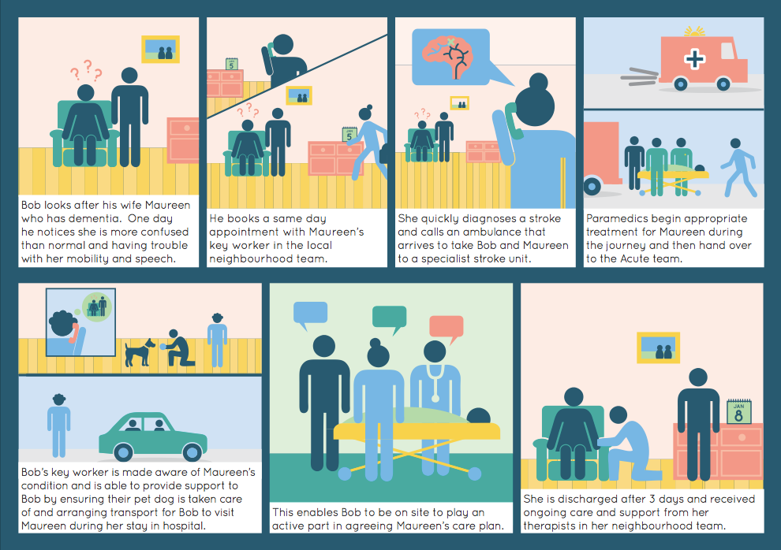
Effective communication and engagement
Mapping core motivations of different stakeholders
Engaging seldom heard groups
Local areas are increasingly co-producing communication and engagement strategies with service users, patients and carers so that they reflect local priorities and needs.
Multi-channel approaches to engaging people so that they understand their role in relation to integrated care
Maggie and Rose’s story – Islington
Lincolnshire integrated care story boards

Slide 5
Co-producing new models of care
Thurrock Local Area Coordination
Local Area Coordination helps vulnerable people in Thurrock find support in their local communities. It aims to support older and people increase their health and wellbeing
Local area coordinators get to know local groups, organisations, businesses and individuals, looking for ways to link people into their communities and match them with others with similar passions and strengths.
Local area coordinators were recruited using an intensive citizen-lead co-production process
Sandwell Community Offer
The Sandwell Community Offer is made up of six pilot schemes operating across Sandwell, part funded through BCF.
Shaped through co-productive events, community meetings and coproduction working group.
Schemes involves voluntary organisations working together to offer people support to reduce demand.
Each schemes offers a different range of services based on the needs of each area, e.g. friends networks, exercise classes

