Slide 1
LHA affordability – three bedroom rate

Slide 2
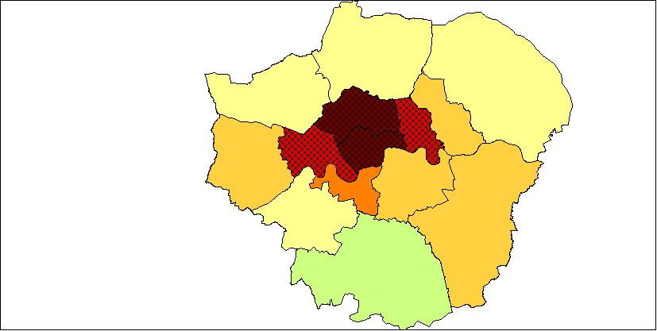
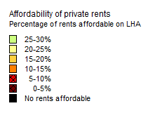
Three bedroom – 2015-16

Slide 3
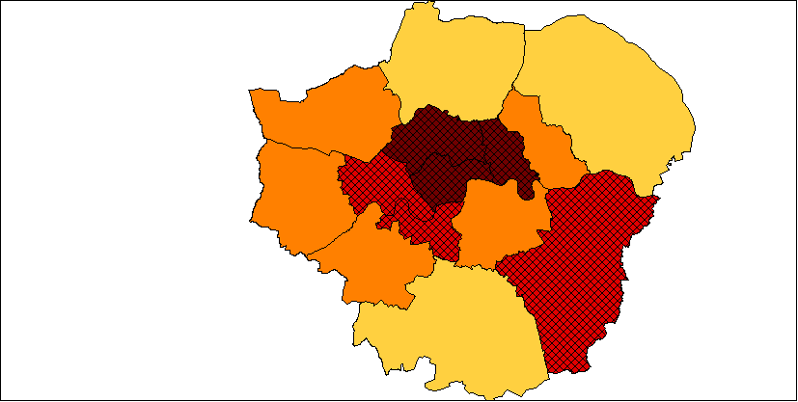
Three bedroom – 2016-17

Slide 4
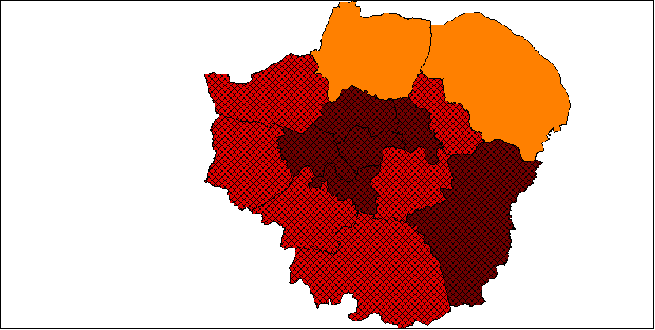
Three bedroom – 2017-18

Slide 5
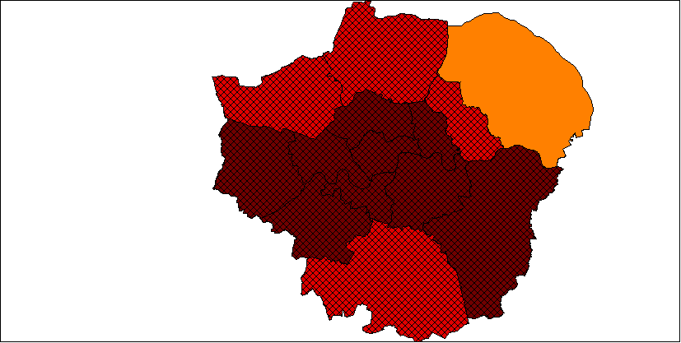
Three bedroom – 2018-19

Slide 6
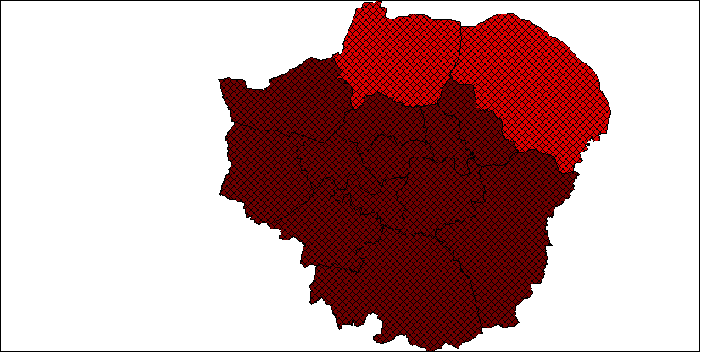
Three bedroom – 2019-20

