Slide 1
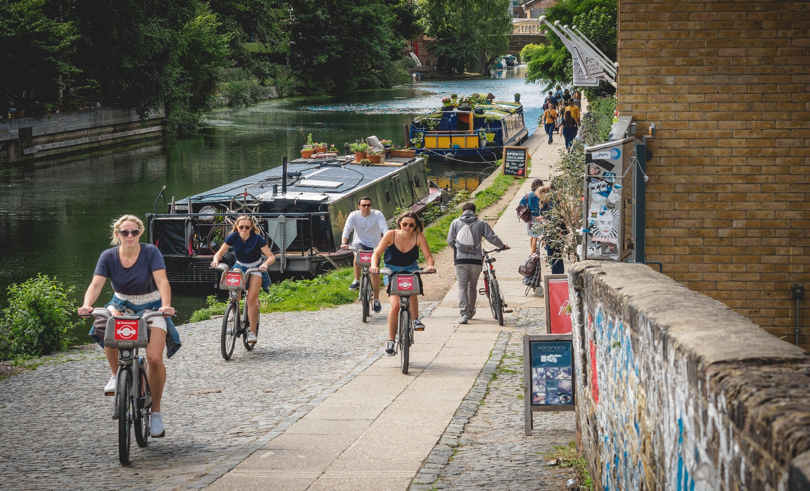
Hackney Devolution Pilot Cllr Jonathan McShane & Devora Wolfson

Slide 2
The start of our journey
In November 2013, the Health in Hackney Scrutiny Commission reviewed the issue of increased GP waiting times in Hackney; rising GP waiting times had to be considered within the context of growing patient/resident demand and reducing public sector resources
This served as catalyst - Systems leaders from across health and social care commissioners and providers in Hackney came together to work more closely to address these challenges
We developed a shared ambition to achieve improve health and care outcomes for local people; better manage demand and make the most effective use of reducing public sector resources through whole systems working.

Slide 3
What we did
The Hackney Leadership Summit was established in Summer 2014 to provide a forum for leaders to meet to collectively address these issues
The Summit allowed leaders to have open and difficult conversations about the sustainability of the health and social care system locally and develop strong relationships
A number of options were considered including moving to more joint commissioning and shared provision.
Partners concluded that devolution provided the opportunity to better address the challenges the borough faces; and come together to initiate a collective and ambitious approach will really make a difference to what we can deliver for local people
In 2016, the partners jointly submitted a bid for Hackney to become a pilot area for devolution. An updated bid was submitted in November 2017.
It was agreed that integrated commissioning would provide a vehicle for us to achieve our ambitions - the City of London Corporation became a partner in this work in 2016.

Slide 4
Who is involved?

Slide 5
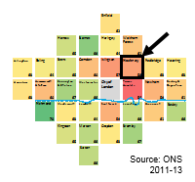
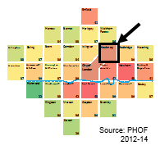
City and Hackney’s Profile
Provider landscape:
~80% of C&H acute activity goes through Homerton Hospital
Stable A&E attends but rising emergency admissions
Low use/spend on outpatients
Outstanding (CQC) Mental Health trust: East London Foundation Trust
All 43 GP practices part of GP Confederation
Strong voluntary sector provision
Strong history of joint pathway work between GPs and secondary care (previous primary care commissioning consortia in place prior to CCG)
1 CCG area
2 local authorities (Hackney and City of London)
Hackney: 279,000 population and 7300 City population (GLA)
308,000 CCG registered population
Hackney:
Highly diverse
High levels of deprivation (influx of younger, more affluent population: gentrification but Hackney still very deprived overall)
Young population but increasing over 65s
City demographics
Affluent with pockets of high deprivation
Large working population influx in week (~300,000 each day)
Male life expectancy
Health needs and prevalence of lifestyle factors mainly related to deprivation and diversity: low levels of physical activity, high childhood obesity, high smoking prevalence; LTCs, premature mortality from CVD, infant mortality, high levels of SMI, inequalities in access/outcomes …
Childhood obesity

Slide 6
Our Collective Ambition
Improve the health and wellbeing of local people with a focus on prevention and public health, providing care closer to home, outside institutional settings where appropriate, and meeting the aspirations and priorities of the 2 Health and Wellbeing Board strategies;
Ensure we maintain financial balance as a system and can achieve our financial plans;
Deliver a shift in focus and resource to prevention and proactive community based care;
Address health inequalities and improve outcomes, using the Marmot principles in relation to the wider determinants of health;
Ensure we deliver parity of esteem between physical and mental health and ensure that we address the physical and mental health needs of our residents holistically
Ensure we have tailored offers to meet the different needs of our diverse communities;
Promote the integration of health and social care through our local delivery system
Build partnerships between health and social care for the benefit of the population;

Slide 7
Our Governance Structure
London Borough of Hackney
City of London Corporation
Each ICB makes recommendations to its respective LA on aligned fund services
Each LA agrees an annual budget and delegation scheme for its respective ICB (with C&H CCG)
Agree outcome improvements and progress across the system
Delivery of HWB strategies
Delegated decision making for pooled budget
Receive financial reports
Hackney Integrated Commissioning Board
Hackney HWB
Care workstreams
City and Hackney Joint Transformation Board
Recommendation and advice
Workstreams report into and make recommendations to TB
Implementation of decisions
City of London Integrated Commissioning Board
City of London HWB
Includes:
CYPM
Prevention
Planned
Unplanned
Meets in common to ensure alignment
Recommends contracts with primary care
Recommendations for aligned fund services
Each year agrees budget and scheme of delegation (with local authority)
Recommends contracts with primary care
Local GP Provider contracts committee
City and Hackney CCG

Slide 8
4 Our Workstreams
Unplanned Care
(SRO – Tracey Fletcher, HUHFT)
Neighbourhoods
Discharge
Single point of contact
111
End of Life Care
Planned Care
(SRO – Simon Cribbens, CoLC)
Outpatient transformation
Continuing care (including CHC processes and pooling budgets) and residential care
Cancer
IAPT
Anti-coagulation
Community health services
Housing
Prevention
(SRO – Anne Canning, LBH)
Prevention and management of diabetes
Smoking: new cessation services, targeting high smoking prevalence groups and Smokefree sites
Prevention and management of stroke and respiratory disease
Increase NHS Health Checks
Smoking and alcohol brief advice within acute settings (developing model for Making Every Contact Count)
Workplace health
New sexual health service models
Joint Healthier Hackney and City Fund
Children, Young People and Maternity Services
(SRO – Angela Scattergood, LBH)
Improving Children’s and young people’s emotional health and wellbeing, including CAMHS
Health support for vulnerable groups to reduce health inequalities
Improving the offer of care across Maternity and Early Years
The partnership has agreed to organise its work around four priority workstreams, each with its own key areas of focus and transformation initiatives. Each workstream has a Clinical/practitioner lead and a Public and Patient Representative.

Slide 9
Engagement of Patients and the Public
Public and patient voice informs all of our work through a network of patient and user groups across health and social care
Public and Service-user representatives are represented in all of the workstreams and other decision-making structures
We have established an Engagement ’enabler group’ with a specific focus on ensuring patients are fully involved in all service redesign
The engagement group has led on the development of a ‘Co-Production Charter’, for patients to be involved at all stages of design

Slide 10
Key Lessons from our Pilot
The time it takes to build trust and strong partnership arrangements, reduce organisational silos and develop a systems approach
Importance of having open and sometimes difficult discussions with partners
Ability to flex our approach whilst keeping a strong focus on what we want to achieve
Importance of patient and resident engagement
Getting strong clinical /practitioner and member leadership throughout our work
Effective communications both across the system and within organisations

Slide 11
Our achievements this year include:
Service redesign and improvement
Working as a system to improve DToC
Agreeing a neighbourhood model for delivery of services within 8 communities
Implementing the local model for extended GP access (8am -8pm) and the north hub
Expansion of the primary care anticoagulation service
Systems improvement
Strong provider collaboration on service redesign and delivery, e.g. neighbourhoods
Developing systems ways of working inc. collaborative working between commissioners and providers

Slide 12
Our challenges
Working within the complex system of integrated commissioning on City and Hackney and the wider STP area
Balancing delivery of transformation at pace whilst ensuring ‘business as usual’ continues
System cost pressures and `working towards a systems financial control total over the next 3 years
.

Slide 13
What devolution could offers us locally
Potential to use our local estates differently to release capital for the delivery of integrated and community based care, and help meet housing needs
Agreement of new contracting and payment models for integrated care models of delivery which incentivise provider collaboration
Being able to use the transfer of work and health programme funding locally to improve our local employment offer
Making use of additional London powers in relation to tobacco, unhealthy food and alcohol to support our prevention activity
However, none of this will be in place for some time ….

Slide 14
Next steps for our pilot:
We are working towards becoming an Accountable Care System - we meet all of the national criteria, except for the minimum population of 500k (our registered population is 308,000)
Reviewing and refining our governance arrangements
More responsibilities delegated to the workstreams
Further pooling of budgets
Further development and implementation of our transformation priorities including neighbourhoods, ‘Making every contact count’, children looked after services, outpatient transformation etc.

