Slide 1
London Career Hubs Clare Ludlow – Principal Project Officer GLA Careers

Slide 2
The London Picture
In London, only 57% of graduates represented in City graduate schemes come from state schools compared to 91% across the nation
Young people with SEND are twice as likely to be NEET
In London’s construction sector, only 4% are young black men, yet young black men make up over 20% of London’s population
The creative industries are the fastest growing sector in London with 1 in 6 jobs related to it
The Mayor is committed to a Carbon Neutral City by 2030 – the Green Economy is a growing sector in London
Only 19% of engineering students are female
Data shows that transitions for students from PRUs/APs is significantly worse for students from other types of educational institutions

Slide 3
To help every young person find their best next step
Co-funded by ESF and CEC
Key ESF Output
To support micro, small and medium sized enterprises (SMEs) to successfully complete projects which increase employer engagement within skills provision.
Key CEC Outputs:
To drive improvement in Gatsby Benchmarks and raise standard of careers provision for London's young people

Slide 4
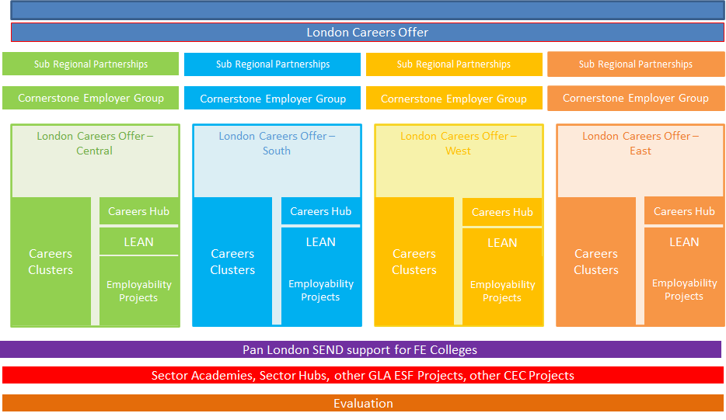

Slide 5
Funding for Careers Hubs £11.1m planned investment over three years
Careers and Enterprise Company (CEC)
European Social Fund (ESF)
Greater London Authority (GLA)
*to note not confirmed as CEC funds are committed annually
£5.9m
£3.6m
£1.6m

Slide 6
KEY MILESTONES, OUTPUTS AND RESULTS
STRAND 1
Achieve improvements in school/college Gatsby Benchmarks
Careers Hub/LEAN staff costs paid
Recruit and support schools/ colleges and match with Enterprise Adviser
Achieve improvements in school/college Gatsby Benchmarks
Establish Cornerstone Employer Group
Deliver LEAN and Careers Hub Project support
Recruit a minimum number of Enterprise Advisers from SMEs, sustain engagement for at least 26 weeks and deliver business benefits (ESF result)
STRAND 2
Recruit employers, including target number of SMEs to deliver employability activities in schools and colleges
Deliver target number of:
Employer Encounters
Employer Insights
Achieve minimum number of SMEs providing >3 encounters/ insights (ESF Result) and deliver business benefits

Slide 7
Gatsby Benchmarks
Notes:
one way we measure success and Progress for schools and colleges is the achievement GBs
We can se that across all GBs London is behind the national
Second graph - we can see that we have made progress across every GB and continue to do so
But what we can take from this is that despite making progress, London is behind the national

Slide 8
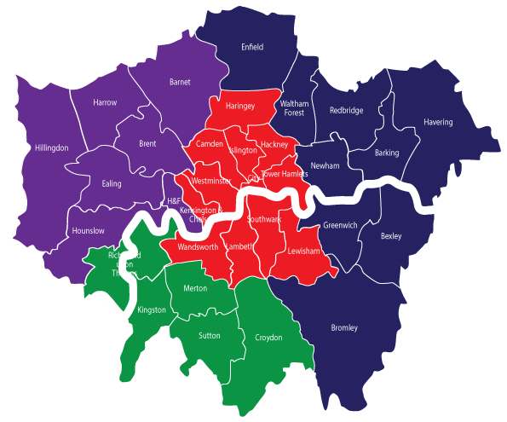
London Career Hubs/ LEAN – Delivery Partners
Notes:
Delivering since 2016
IN 2018 we outsourced deliver and brought partners onboard
Aligned to sub-regions and meaning
School - big and national
EAs - lots of businesses
= truly pan-London and national
Current DPs

Slide 9
Y1
Y2
Y3
Notes:
4 Careers Hubs
Ambition is that over 3 yrs - all schools and colleges chance to be in a hub
Not all schools in Y1. We want to grow and learn.
Responsible for transitioning. More detail in breakout room

Slide 10
South London Careers Hub
Polly Persechino
Programme & Policy Manager, South London Partnership
www.southlondonpartnership.co.uk

Slide 11
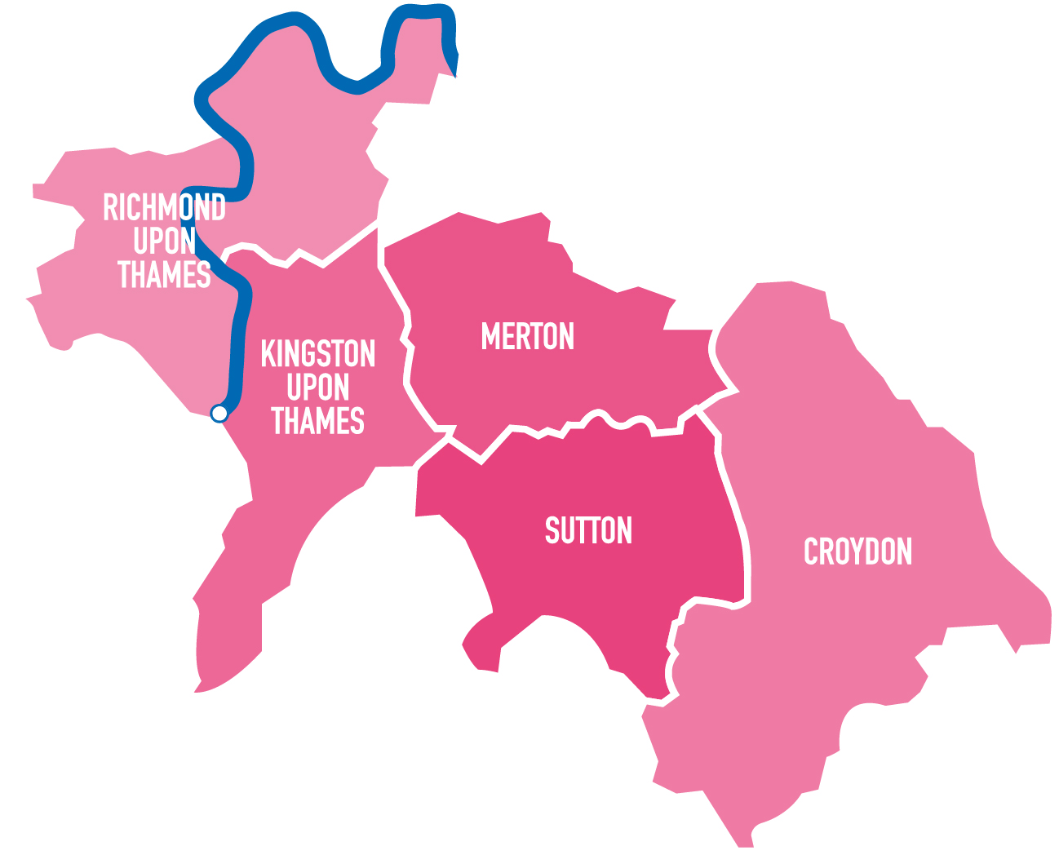
There are four geographical cross-party sub-regional partnerships in London, supporting London boroughs to work collaboratively on programmes, policy and infrastructure.

Slide 12
Creating a new construction workforce talent pool by promoting careers in the construction industry, connecting people to jobs and apprentices and brokering links between employers and training providers.
Supporting people with disabilities and long-term health conditions into work.
Employment support programme helping people who are jobless due to covid, into work
Job creation, innovation and growth programme; creating new workspace and connecting businesses to expertise in universities
Piloting the use of sensors to capture and use intelligence to inform generate economic growth and improve the quality of life for people

Slide 13
The South London Partnership Economic Recovery Action Plan sets out a refreshed set of principles, in light of the impact of Covid-19 on our residents, businesses and economy.
South London Partnership boroughs have agreed to work together to support a fair, sustainable and productive economic recovery across our sub-region.
This includes helping all our young residents to make informed choices about their next steps to prepare our future workforce.
Securing successful delivery of the South London Careers Hub will contribute to a more integrated skills and employment system and help develop the talent pool and future workforce of south London.

Slide 14
In South London we are aiming to
Provide a coordinated, integrated and place-based approach to Careers Education, Information, Advice and Guidance (CEIAG)
Provide strategic support to help shape the future curriculum based on local growth and emerging sectors.
Enable residents to make informed choices and help residents to progress into high quality, sustainable good work
Help south London businesses to develop a local talent pool by brokering and strengthening relationships between schools and colleges

Slide 15
We will achieve this by…
Identifying a pool of Enterprise Advisers who will support the schools and colleges in south London to develop a innovative careers programme
Providing CPD and training for careers leaders and Enterprise Advisers, with access to a wide range of resources.
Highlighting the breadth of opportunities available in the job market, to enable young people to make the right choice about their next steps
Codeveloping exciting careers intervention and events, increasing the number of encounters young people have with employers

Slide 16
There will be 8.5 member of staff helping to coordinate the Careers Hub
1 x
Strategic
Hub Lead
1 x Operations Lead
5.5 x Enterprise Coordinators
1 x Employer Engagement Officer
The Careers Hub will be led by the South London Partnership team

Slide 18
For more information:
Visit: South London Careers Hub
Email:slcareershub@southlondonpartnership.co.uk

Slide 20
OFFER TO SCHOOLS & COLLEGES
Events
•Attendance at Borough/Network Careers Leaders meetings
•Steering Group involving key stakeholders and Cornerstone Employers
•Multi school careers event
Resources (West London specific)
•West London Careers Hub website central information point
•West London specific LMI inc. Infographics/videos linked to key sectors
•SME volunteer toolkit
•Parental support pack
•SEND Resources
Training
•Careers Leader training budget
•Webinars on the Gatsby Benchmarks
•SEND training
Other
•Innovation Fund (Hub schools can apply for fund)

Slide 21
THE TEAM
Strategic Hub Lead
AARTI JASWAL
Operational Hub Lead
LADI MOHAMMED (5th Jan)
Relationship Manager
Vacancy
5
Enterprise Coordinators
MARIA VARELA
LAURA KYME
UCHE OKWUOSA
LEAH JOHN-BAPTISTE
HEENA PATEL
WELLESLEY LAWSON
ASTRID LEY
CAMILLA RISSANEN
Contract Compliance Coordinator
VINAY JOSHI
STRAND 1
CONTACT US: Info@wlcareershub.com
STRAND 2

Slide 22
WORKING TOGETHER TO ESTABLISH AND MAINTAIN A MUTUALLY BENEFICIAL RELATIONSHIP
Understanding key priorities for each Borough
Understanding local set up and provision
Build and establish links
Sharing practice and joint working
Complement existing provision and avoid duplication
Effective communication and sharing of information
Attendance at relevant groups (strategic/operational)

Slide 23
Local London Careers Hub – East Incorporating the London Enterprise Adviser Network
Tracy Eve – Interim Strategic Hub Lead
tracy.eve@redbridge.gov.uk

Slide 24
EAST London Enterprise Adviser Network
166 Schools and Colleges in the Network
16 Special Schools in the Network
154 Matched with an Enterprise Adviser

Slide 25
Careers Hubs
Current position
80 Hub Schools in East London
11 Special Schools
8 FE Institutions
5 Aps
Surveyed Schools & Colleges to understand their priorities in researching the Gatsby Benchmarks.

Slide 26
Careers Hub Offer
Developing: Virtual Careers Weeks supporting our targeted sectors
SMEs/National employers
University Provision
Apprenticeship
College
Communities of Practice
Mainstream
SEND
Guidance
FE
Notes:
Moving towards Careers hubs we are supporting schools and colleges with Gatsby Benchmarks 1 – 8.
Last year we organised a range of training sessions and this year we will work to deliver more training to support you.
Communities of practice are essential for schools to develop their programmes and here more about the good practice being delivered, not only in London but across the country.
Finally, the East London team has just welcomed Caroline Lee, who previously worked in Talentino.
This is because all Special Schools will be supported by the East Team.
We can learn so much from special schools while thinking about how we support SEND students in mainstream.
The website is currently in development and is where we will store all our resources.

Slide 27
Careers Hub Cont…..
START Website –East London Resources Portal
information
news
resources and
links to events
Access to additional activities that will support:
Gatsby Benchmark 5
Gatsby Benchmark 6
SEND Students

Slide 28
Careers Hub Offer
Training for Careers Leaders
In addition to GB 1,5 and 6
Training to support CL on supporting SEND Students
Training for Heads of Department/Curriculum Teachers
Careers in the Curriculum
Support our Enterprise Advisers both with the LEAN and HUB schools.
Notes:
Moving towards Careers hubs we are supporting schools and colleges with Gatsby Benchmarks 1 – 8.
Last year we organised a range of training sessions and this year we will work to deliver more training to support you.
Communities of practice are essential for schools to develop their programmes and here more about the good practice being delivered, not only in London but across the country.
Finally, the East London team has just welcomed Caroline Lee, who previously worked in Talentino.
This is because all Special Schools will be supported by the East Team.
We can learn so much from special schools while thinking about how we support SEND students in mainstream.
The website is currently in development and is where we will store all our resources.

Slide 29
Moving Forward
Memorandum of Understanding for Careers Hub Schools
Promoting of Menu of Services
Compass Evaluation for Term
Working with the Careers Hub Schools continuing to support LEAN Schools.

Slide 30
Central London

Slide 31
Local Collaboration – London Central
Provide the connection between the world of work and schools/colleges bridging the Central London careers space
Link offers of support strategically to where there is the need and will have impact
Ensure there is a reduction of duplication in the careers space and embrace efficiency
Share opportunities and resources to our network
Keen to grow links to those in the borough working in the careers space so we can collaborate and support
Happy to support organisations with CSR priorities or S106 obligations to connect
We would like support connecting to local businesses, including SME’s
Plug into local links and groups to avoid duplication and amplify their work
Support for school/college engagement where there are challenges
Where it works best is where we work together

Slide 32
Local Collaboration – London Central
Michelle Sporle – Strategic Hub Lead
michelle.sporle@reed.com
07725476658
Jenny Kohnhorst – Operational Hub Lead
Jenny.Kohnhorst@reed.com
07395375307
Central Inbox
Londoncareers.central@reed.com

Slide 33
Questions?

