Slide 1
LHA affordability – four-bedroom rate

Slide 2
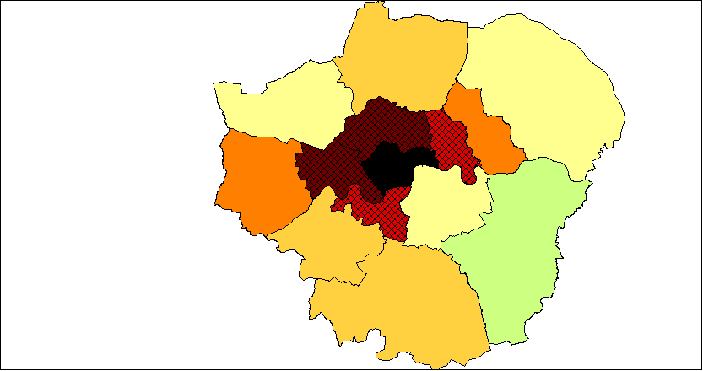
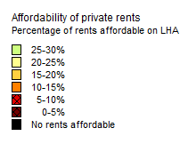
Four bedroom – 2015-16

Slide 3
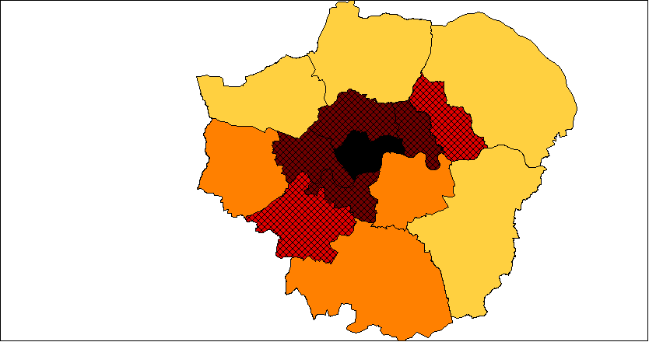
Four bedroom – 2016-17

Slide 4
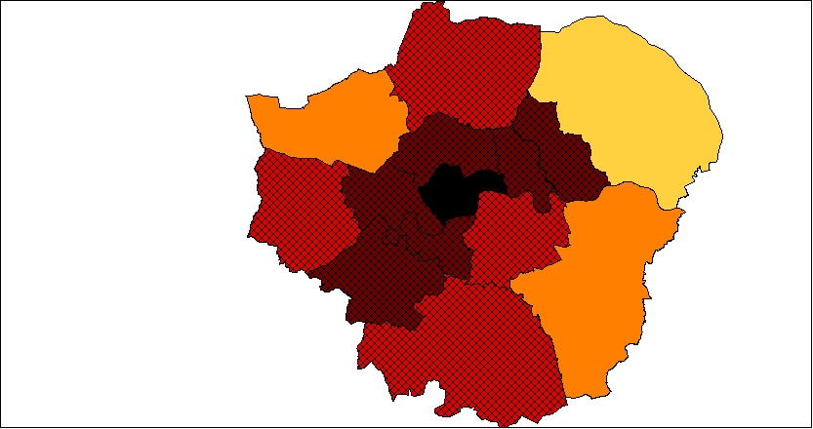
Four bedroom – 2017-18

Slide 5
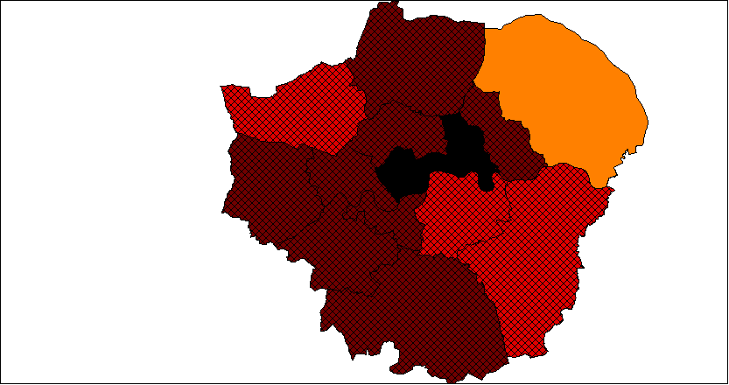
Four bedroom – 2018-19

Slide 6
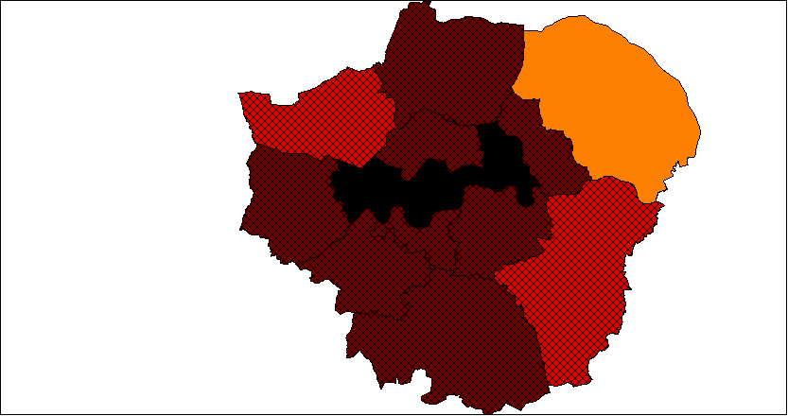
Four bedroom – 2019-20

