Slide 1
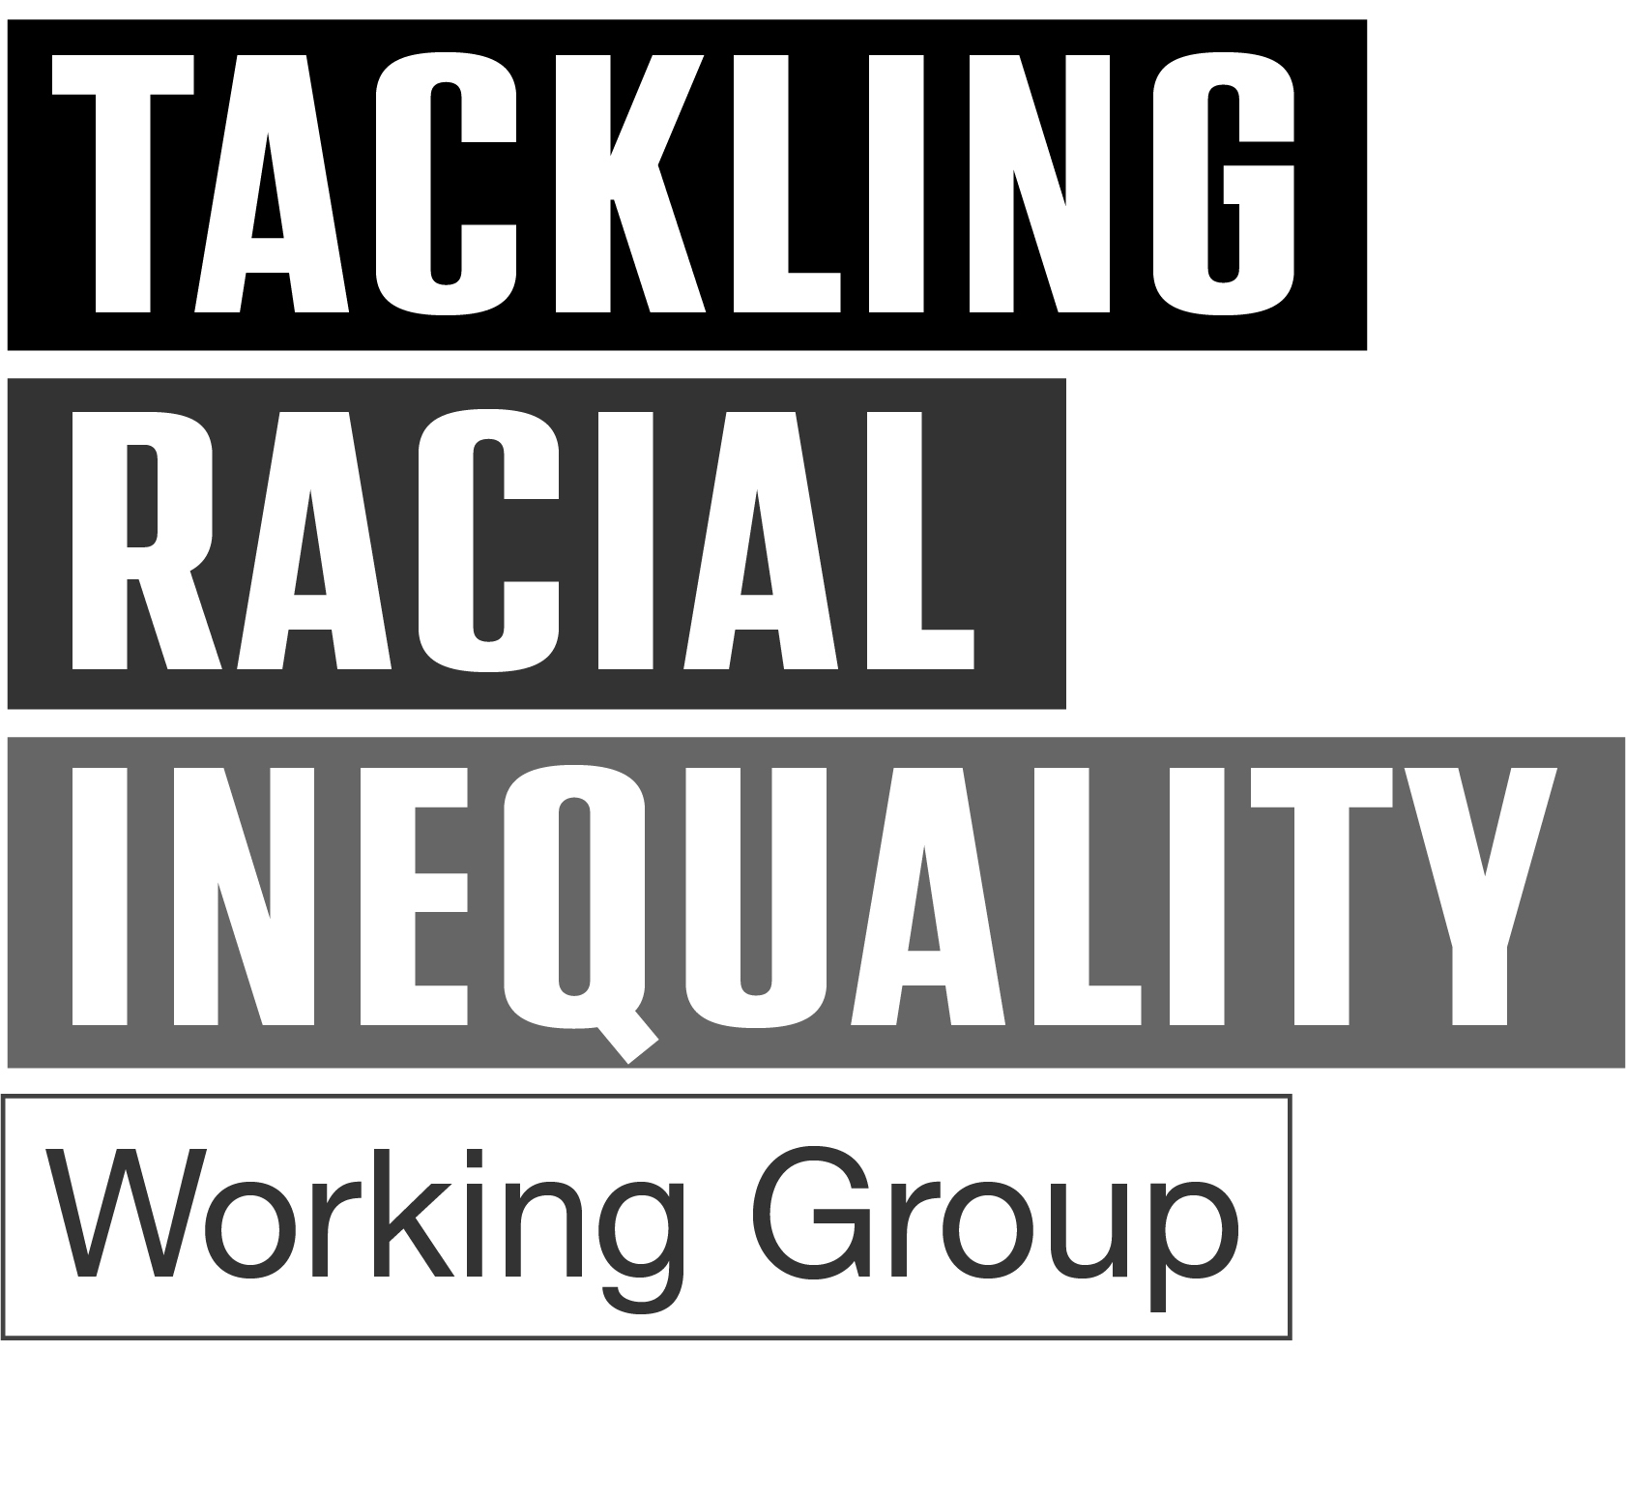
Race Equality, Language & Terminology Across London's Anchor Institutions – Key Findings

Slide 2
Context
This survey is part of a London local government Tackling Racial Inequality exploratory paper which outlines the emerging narrative and importance of language and terminology in relation to race equality, including the use of the acronym ‘BAME’.
The toolkit resulting from this research will use the recognised, preferred language throughout, with the goal of embedding our guiding principles on language.

Slide 3
Context
We surveyed nine terms with the intention of refining the list of suggested language in the public sector.
The final product is a toolkit that includes a full length report, this summary presentation and guidance that supports the conscious use of language in public sector dialogue and contains a list of suggested terms for Ethnically Diverse communities based on the survey outcomes.
The aim is to capture the views and preferences of local government and partner organisations regarding terminology and language, particularly collective terms.

Slide 4
Key Takeaways
Ethnically Diverse respondents preferred not to be referred to by collective terminology that includes all backgrounds except White British.
‘Ethnically diverse’ and ‘Black, Asian & Multi-Ethnic’ are the overall preferred terms.
Qualitative insights indicate that respondents prefer language that:
Is factual and / or empowering
Avoids using ‘minority’
Avoids homogenisations
Avoids vague terminology

Slide 5
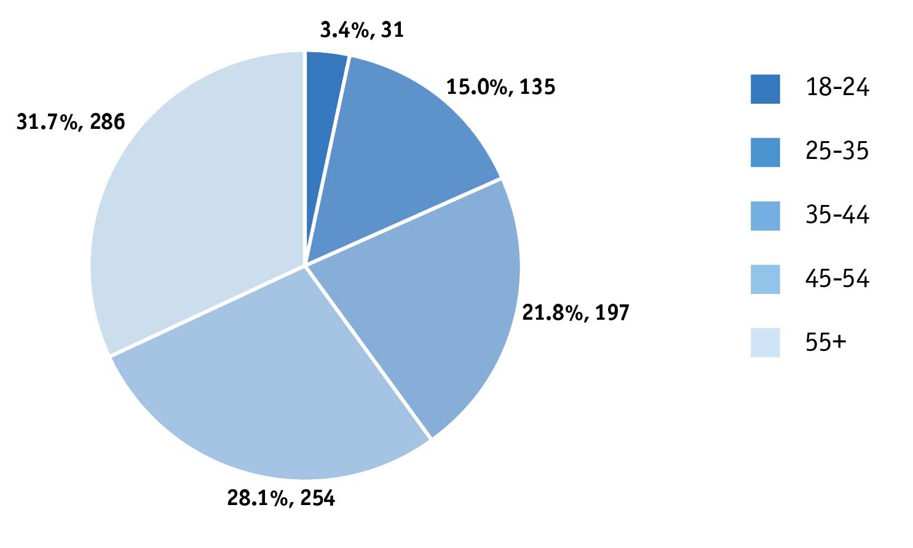
Personal characteristics
The survey captured data from respondents around their age, sector and ethnicity
Most respondents were aged 45+ (59.8%) which is likely reflective of the sectors the survey engaged with

Slide 6
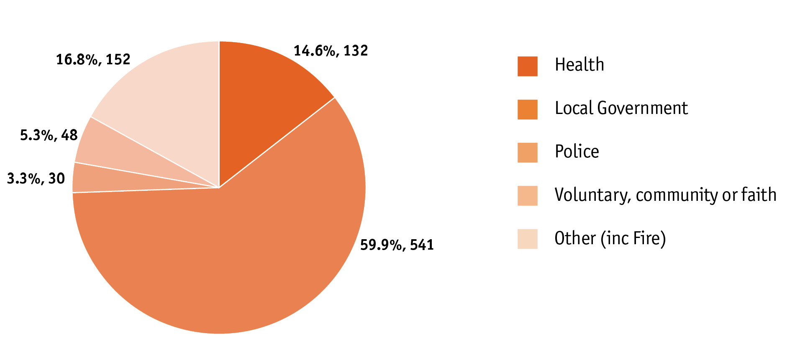
Personal characteristics
The majority of respondents
worked in local government
(59.9%)

Slide 7
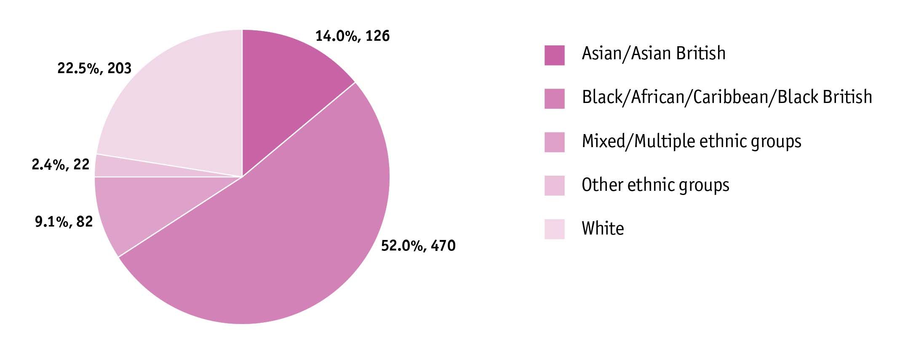
Personal characteristics
Most respondents (52%) were from Black/African/Caribbean/Black British backgrounds.

Slide 8
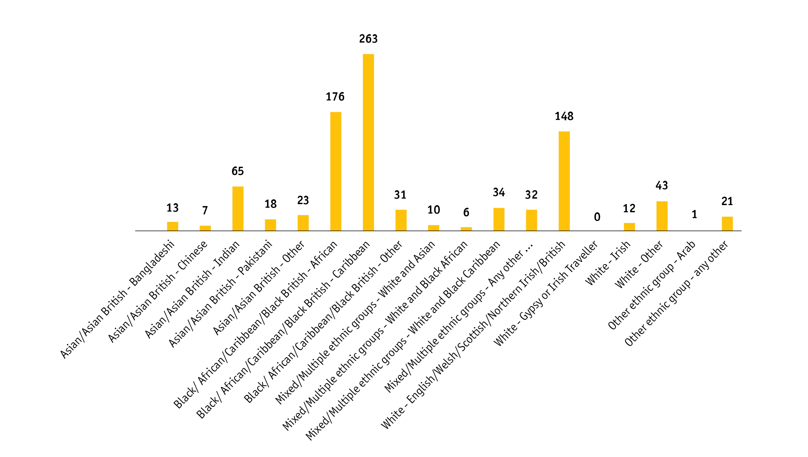
Personal characteristics
Granular breakdown

Slide 9
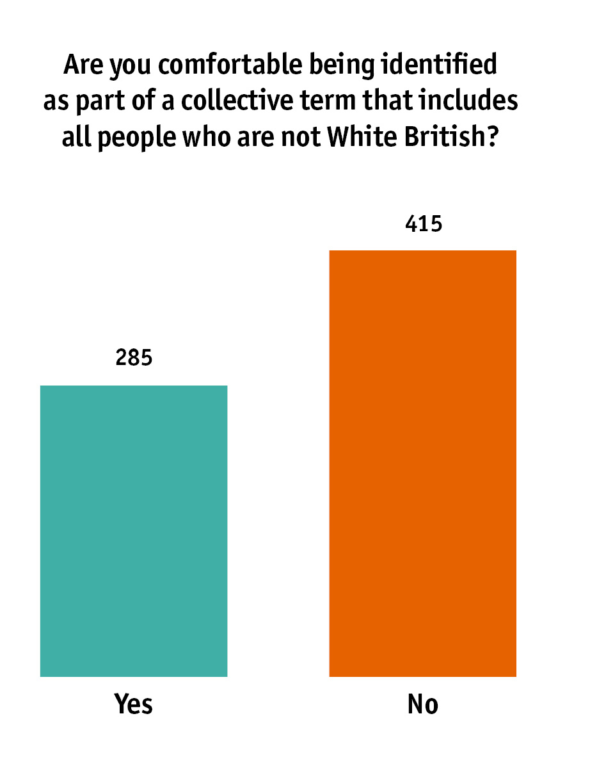
Scope of a collective term
Respondents who identified as Ethnically Diverse were asked if they were comfortable being categorised by a collective term that encompasses all backgrounds except White British. Overall, respondents were not in favour.
However, when broken down by different ethnic groups:
Asian and Mixed/Multiple respondents were marginally in favour
Black respondents were overwhelmingly against
‘Other ethnic group’ respondents were marginally against.

Slide 10
Preference of terminology
This survey aimed to understand the language and terminology preferences of respondents when collectively describing Ethnically Diverse communities. The survey captured which terms, from a list of given terms, respondents had a positive and negative preference towards. Collectively, the findings were the following:

Slide 11
Positive preference
When analysing terms with the highest positive preference, the following four terms emerged:
Ethnically diverse
Black, Asian and Multi-Ethnic
People from ethnic minority backgrounds
People of Colour

Slide 12
Positive preference
When analysing preferred terms, ‘Ethnically diverse’ emerged as most popular with ‘Black, Asian & Multi-Ethnic’, ‘People from ethnic minority backgrounds’ and ‘People of Colour’ making up the remainder of the top four.
Terms that appear within ‘other’ included a range of ways to specifically describe someone’s background e.g. Black African or Black Caribbean. There were also references to ‘underrepresented group(s)/people’ and some stated they didn’t prefer any of the given terms.

Slide 13
Negative preference
When analysing terms with the highest negative preference (the least favoured), the following four terms emerged:
Racially minoritised or ethnically minoritised
Black, Asian and Minority Ethnic
Black and Brown People
People of Colour

Slide 14
Negative preference
When analysing preferred terms, ‘racially minoritised or ethnically minoritised’ emerged as least popular with ‘Black, Asian & Minority Ethnic’, ‘Black & Brown People’ and ‘People of Colour’ making up the remainder of the top four.

Slide 15
Overall (net) preference
When combining the positive and negative preferences, only two terms emerged with a net positive preference:
Ethnically diverse
Black, Asian and Multi-Ethnic

Slide 16
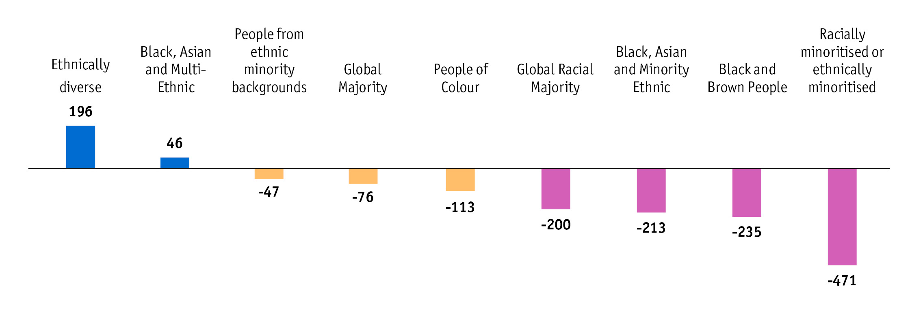
Language & terminology overall preference
When combining the overall positive and negative preference for each term, only two terms emerged with a net positive preference. However, several terms emerged as having an overwhelmingly negative preference.

Slide 17
Qualitative analysis
The qualitative responses of the research have allowed the programme to develop four guiding principles on language and terminology rather than prescribe particular terms:
Specificity – be as factual as possible and avoid all-encompassing collective terminology
Context – be guided by context of the situation and if it is not decisive use preferred terms interchangeably to reflect the complexity of individual and community identity.
Empowerment - choose terminology that centres on empowerment and positivity.
Choice and transparency - always engage groups and recognise their right to choose as well as the overall challenge in establishing a consensus. The approach to language should always be open and transparent

Slide 18
Annex A - Scope of a Collective Term: Age, Sector and Ethnicity Breakdown

Slide 19
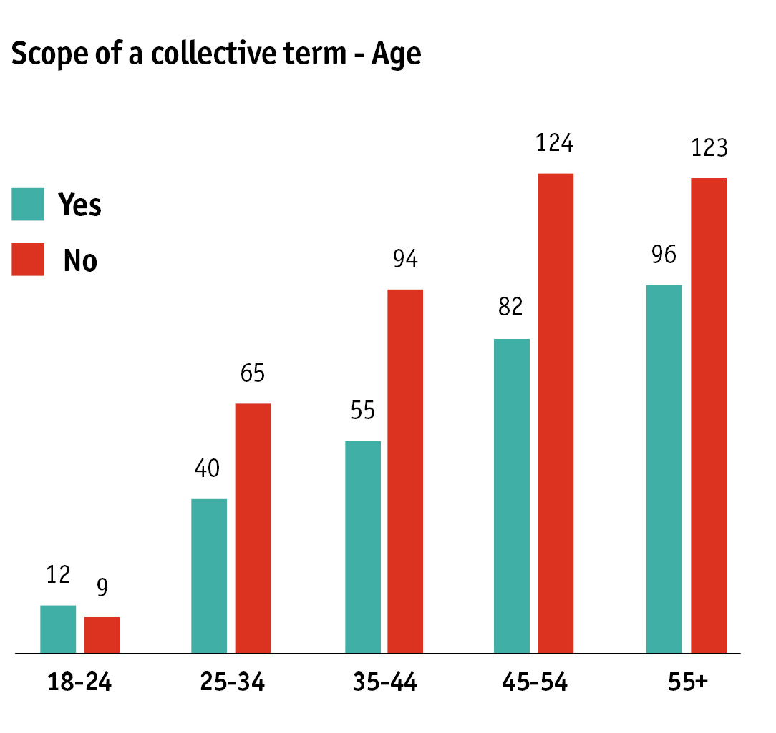
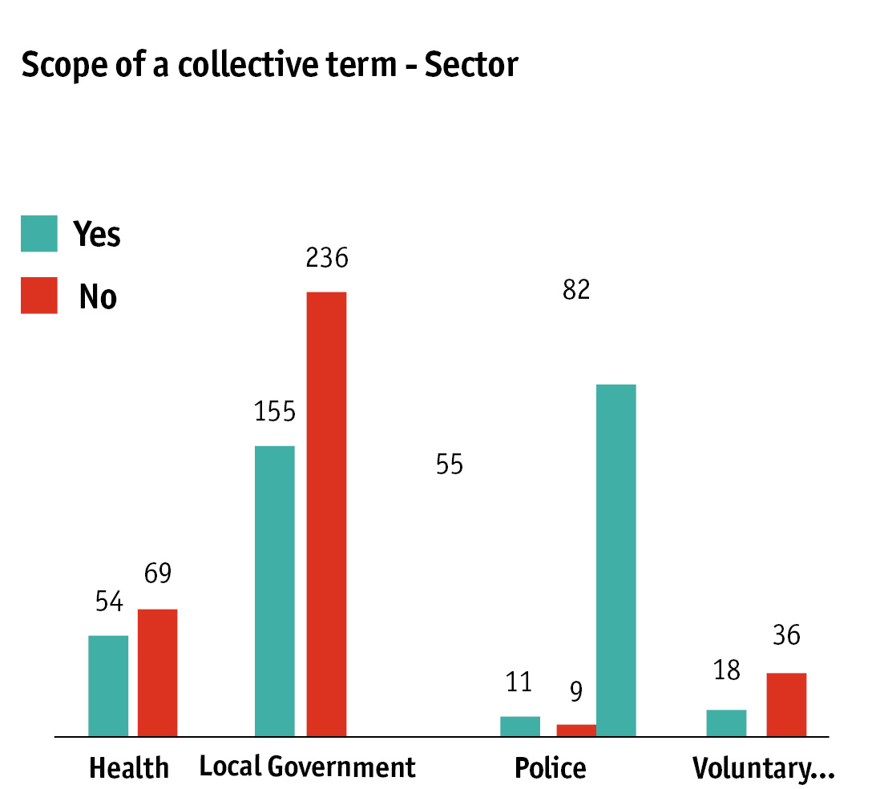

Slide 20
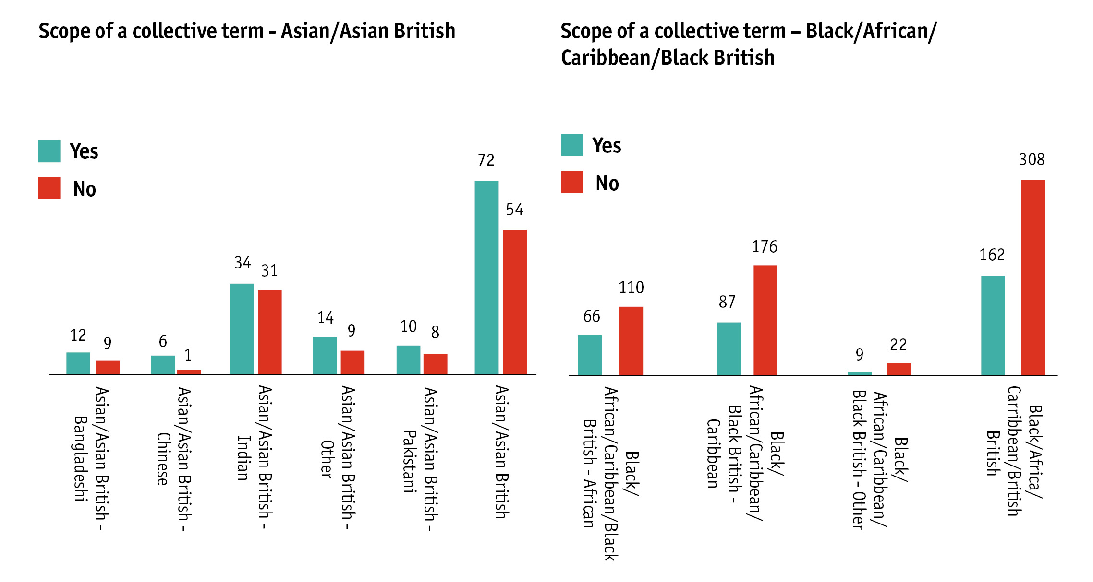

Slide 21
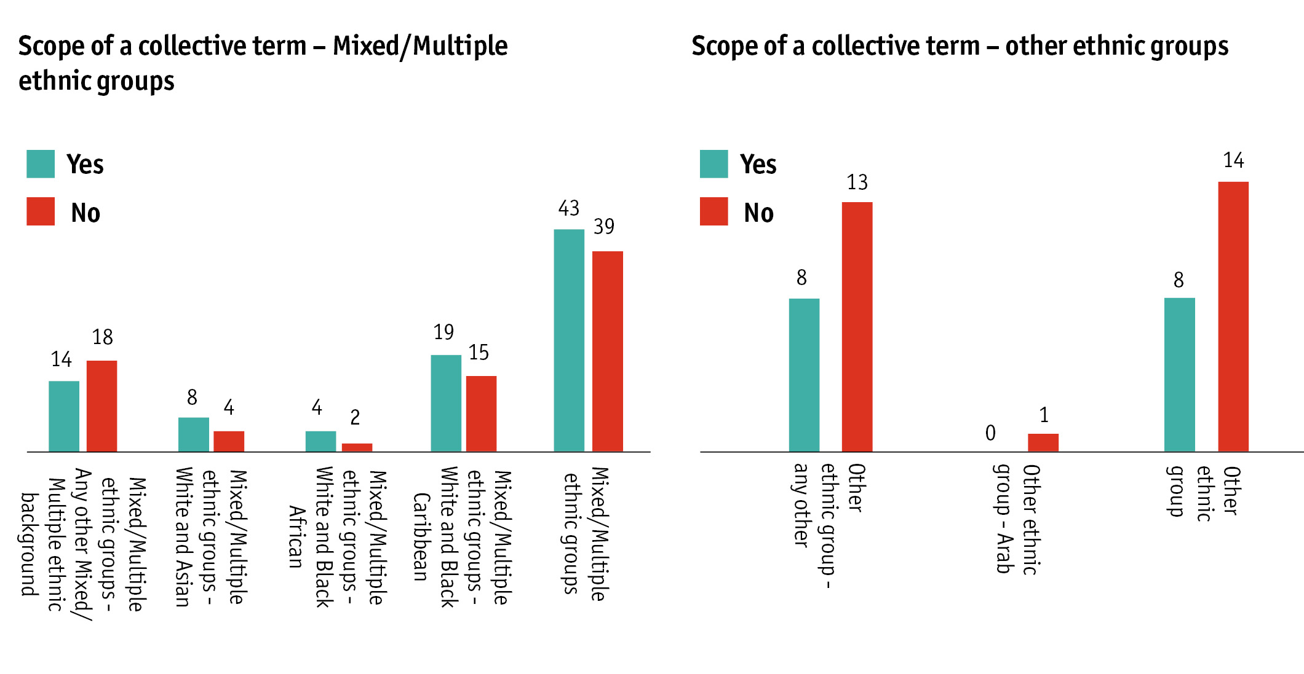

Slide 22
Annex B – Overall Summed Preferred Terms: Age, Sector and Ethnicity Breakdown

Slide 23
Age

Slide 24
Age

Slide 25
Age

Slide 26
Sector

Slide 27
Sector

Slide 28
Sector

Slide 29
Ethnicity

Slide 30
Ethnicity

Slide 31
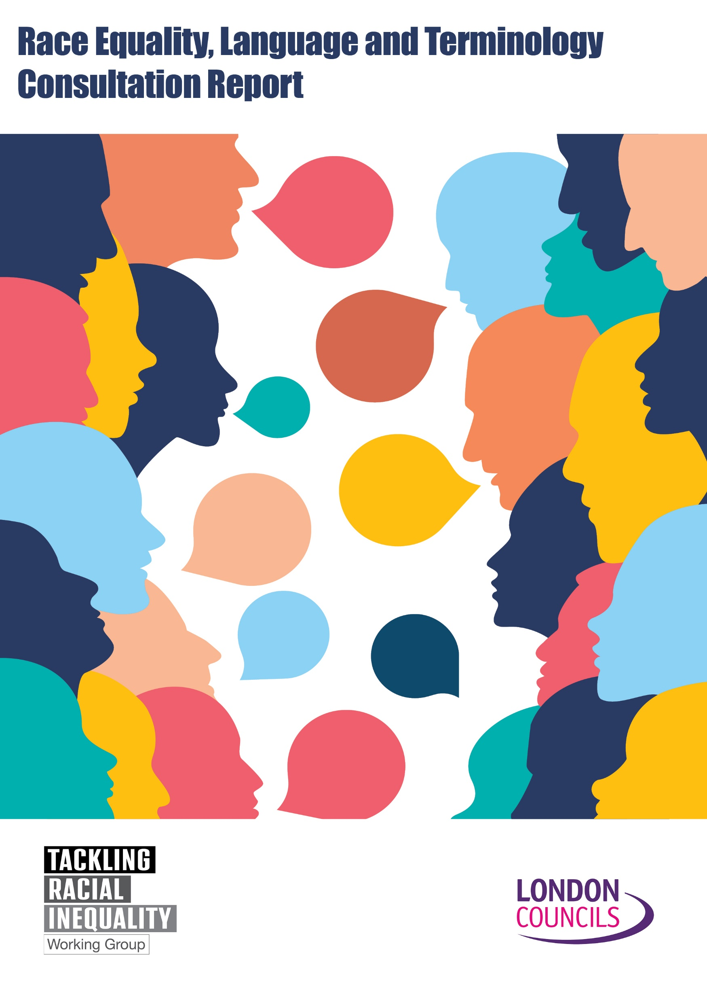
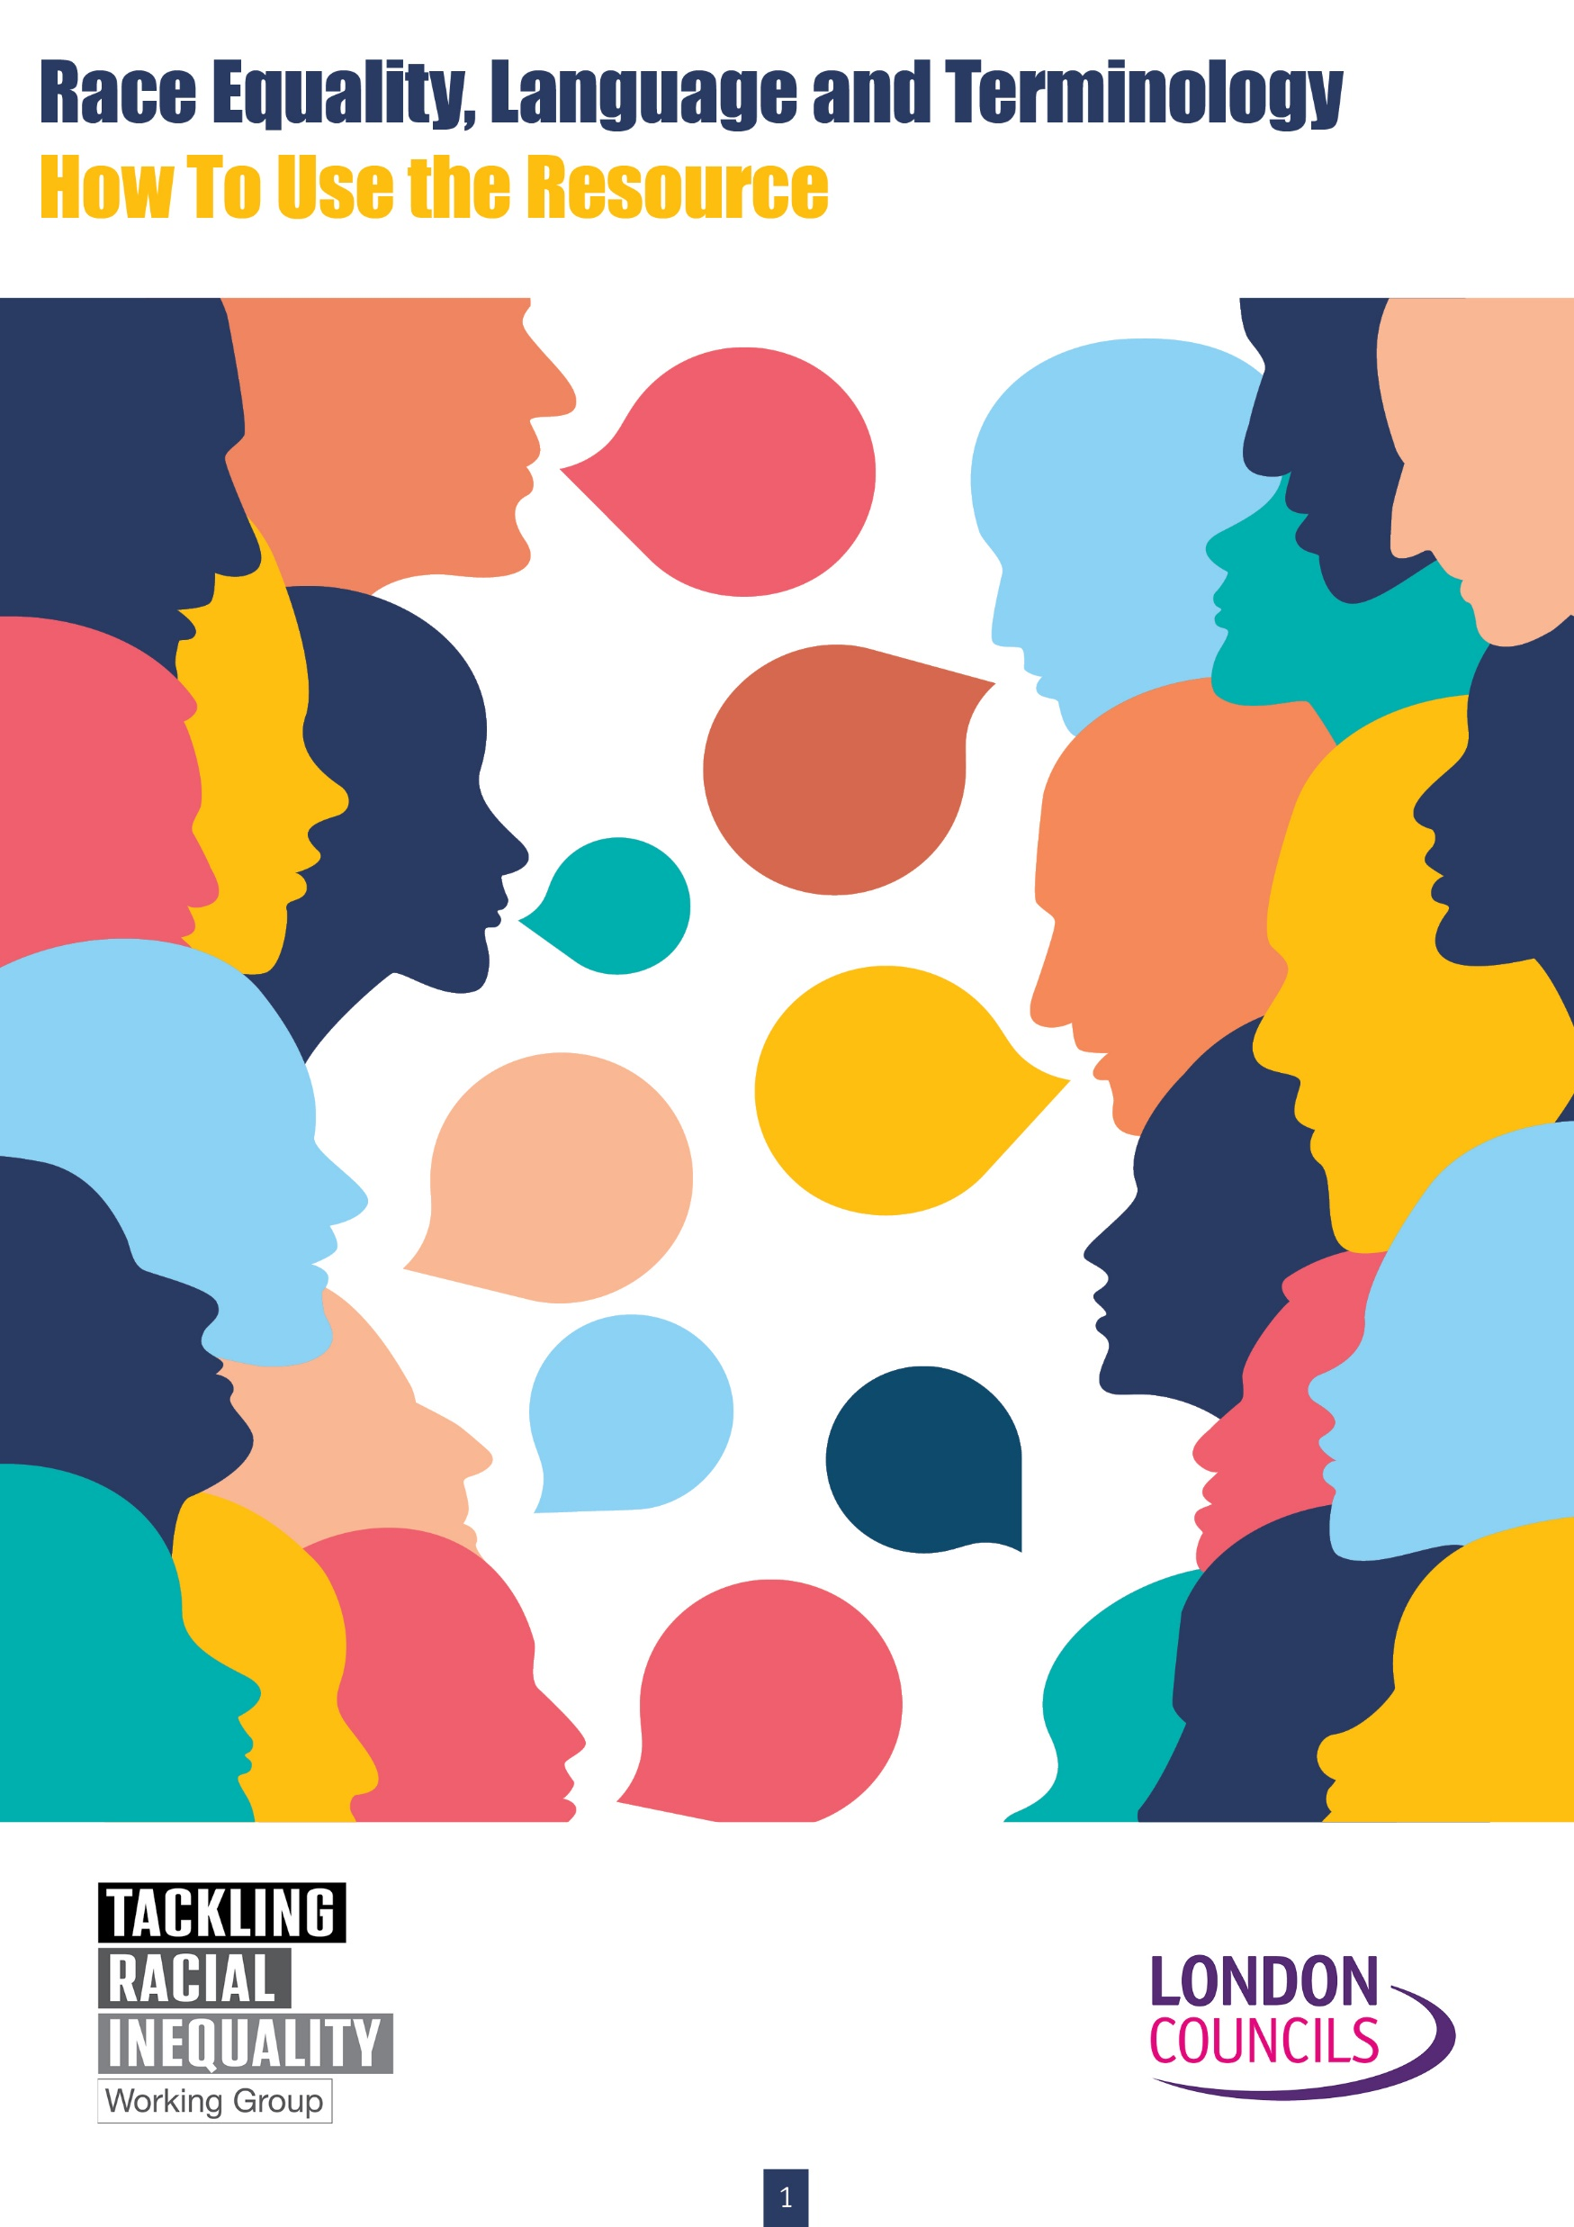
Any questions?
Nancy Hunt, Report author and Tackling Racial Inequality Programme Officer
nancy.hunt@londoncouncils.gov.uk
Juliet Amoa and Yvone Oikyo, Co Chairs, Demonstrating Leadership Group
jamoa@lambeth.gov.uk yvone.oikyo@lbhf.gov.uk
Swazi Kaur, Tackling Racial Inequality Programme Manager
swazi.kaur@londoncouncils.gov.uk

